Slide 1

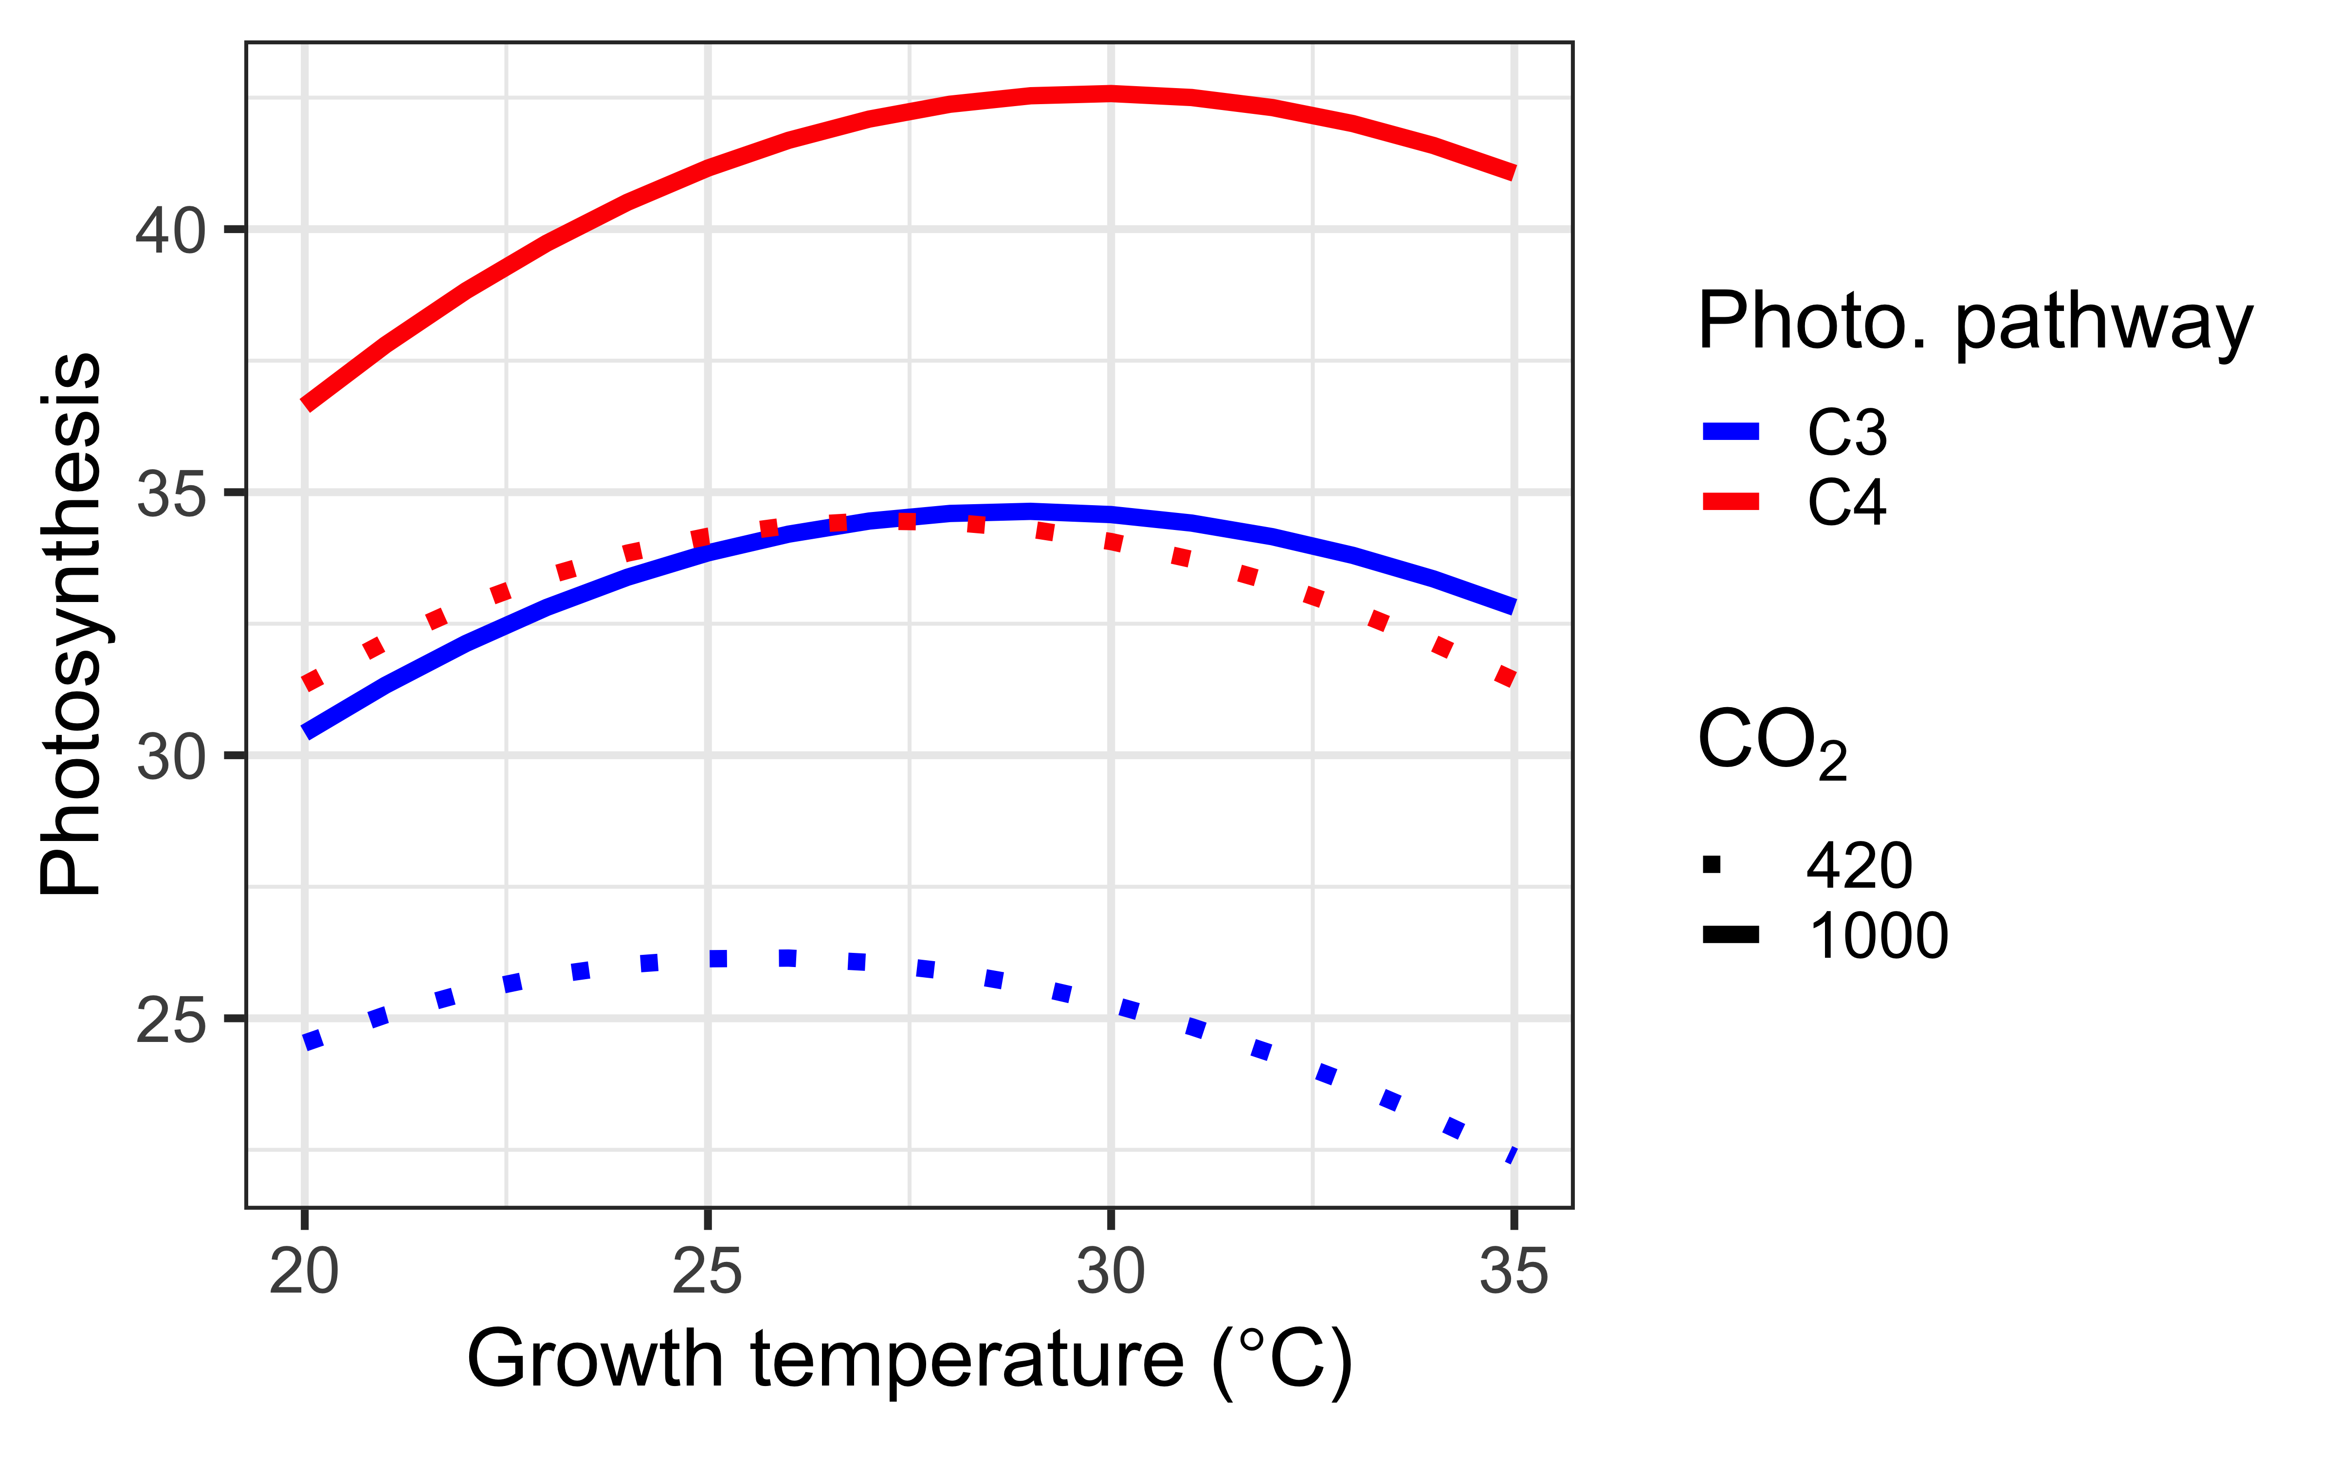
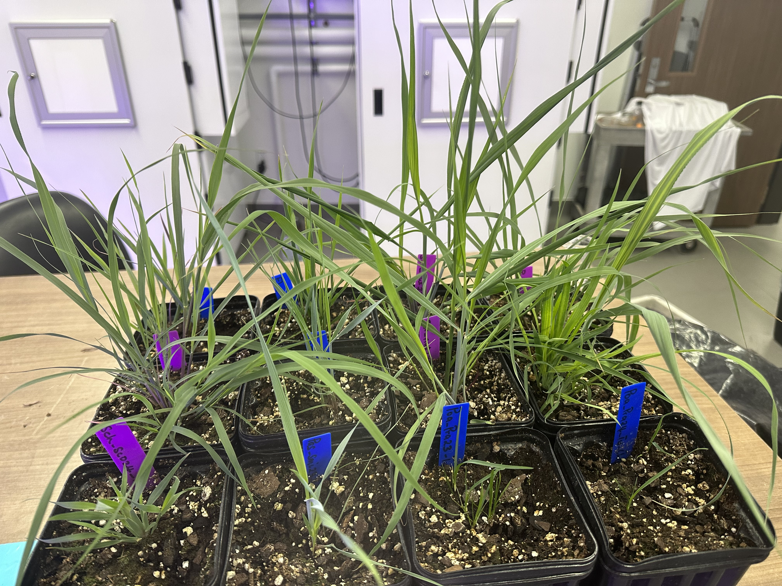
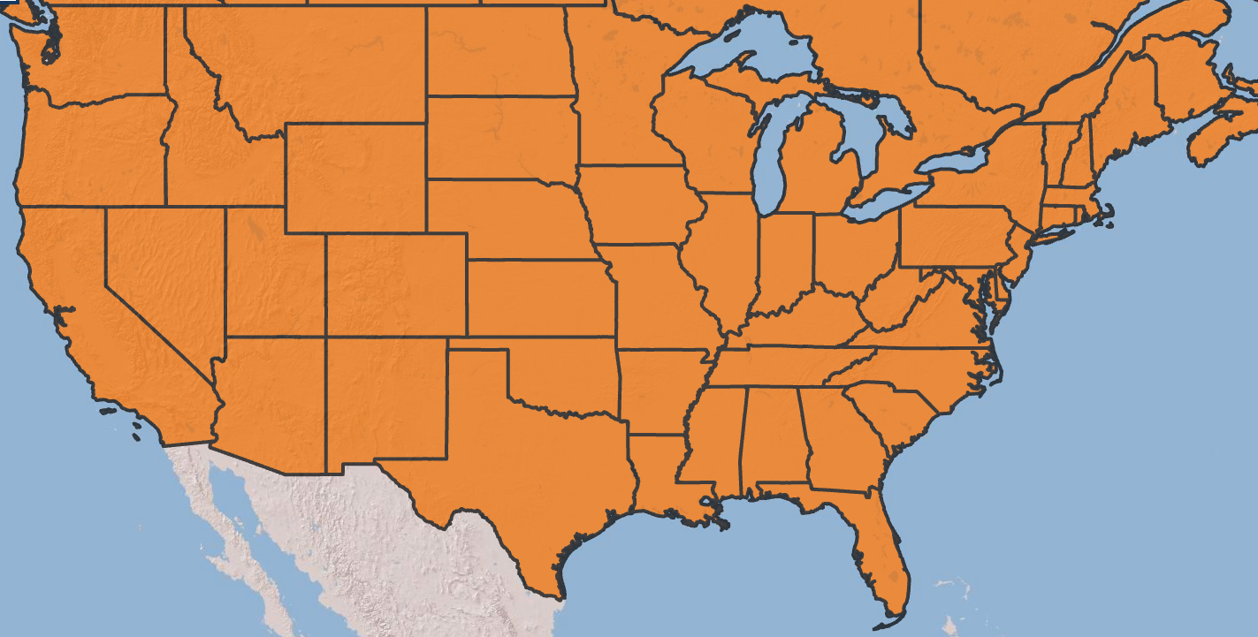
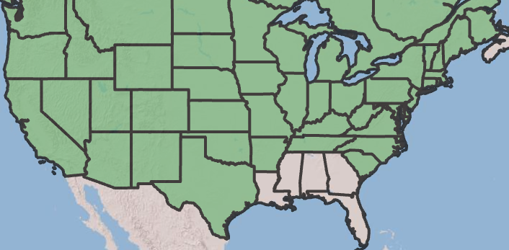
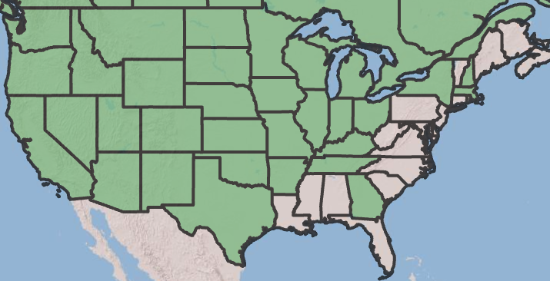
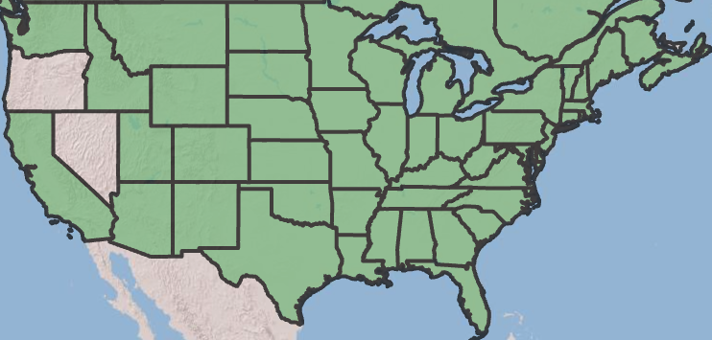
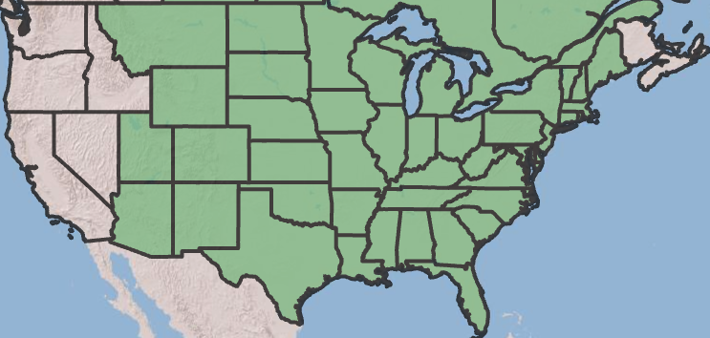
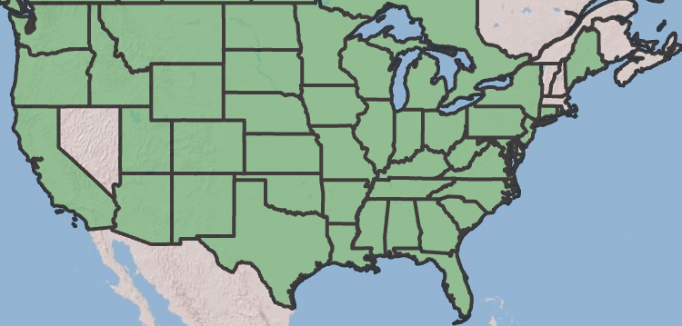


Experimental evaluation of the theoretical acclimation response of C₃ and C₄ grasses to temperature and carbon dioxide (CO₂)
Ezinwanne Ezekannagha and Nicholas G. Smith
Department of Biological Sciences, Texas Tech University, Lubbock, TX, USA
INTRODUCTION
THEORETICAL EXPECTATIONS
All data from theoretical model described in Scott and Smith (2022).
Earth system models are sensitive to the representation of photosynthetic processes and photosynthetic acclimation in particular.
Photosynthetic acclimation is a change in the instantaneous response of stomatal functioning and photosynthetic biochemistry to an environmental driver that improves carbon uptake and resource use efficiency.
Acclimation responses are expected to differ between C₃ and C₄ plants, but these responses are not well tested.
We used a temperature-by-CO₂ manipulation experiment to test whether acclimation responses to temperature and CO₂ differ between coexisting C₃ and C₄ species.
Experiment results will be used to test predictions from a recently developed C₄ optimality model (Scott and Smith 2022).
 | 420 ppm | 1000 ppm
20°C | 22% | 17%
35°C | 29% | 20%
Percent advantage in photosynthetic carbon assimilation rates for C₄, relative to C₃ plants. C₄ is always expected to have an advantage over C₃ plants, but the advantage decreases under increasing CO₂ (shade of green is proportional to the relative advantage of C4 over C3 photosynthesis).
C₄ species will have greater acclimated photosynthetic rate than C₃ species, but this effect diminishes under increased CO₂ and lower temperatures (see table).
EXPERIMENTAL DESIGN
We compared photosynthetic acclimation responses between six coexisting C₃ and C₄ species.
Plants were grown under two temperature (day/night: 20/10°C and 35/25°C) and two CO₂ treatments (420 ppm and 1000 ppm) in a full-factorial design.
In both plant types, V_{cmax25} decreases with temperature, but decreases with eCO₂ in only C₃ species
J_{max25} decreases with
temperature and increases
with eCO₂ in both plant types, but the temperature response is greater in C₄ species
The ratio of intercellular to atmospheric CO₂ (χ) increases with temperature similarly between plant types but decreases with eCO₂ only in C₃ species
V_{pmax25} decreases with eCO₂ and increases with temperature
C₃ species
Poa
pratensis
Pascopyrum smithii
Elymus canadensis
FUTURE WORK
The outcome of this project will be used to enhance the representation of acclimation in ESMs. Subsequently, the refined acclimation processes will be integrated into an ESM framework, specifically the Community Earth System Model. We will model the influence of acclimation on plant community dynamics, with a particular focus on grassland ecosystems where C₃ and C₄ species coexist. This integration will likely improve carbon storage and climate change predictions in ESMs. `
C₄ species
Sorghastrum nutans
Schizachyrium scoparium
Bouteloua curtipendula

